Slide 1
Jinx Customer Support ChatBot

Slide 2
Tech Stack
Technical Complexity
NLP LLm: Dialogflow, ngrok
Frontend: Html,Css,React Js, Nodejs
Api: Flask Api
Database: Sql workbench
Software: Visual Studio
Diagflow:
Requires Configuring Intents , entities
and context to interpret accurately
Multi-platform Deployment:
Requires consistent user experience and
seamless API integration
React Js:
Managing State,handling components and
integrating api.
Flask Api:
Creating and manging routes,handling
backend with database integration

Slide 3
Social Impact
Accesibility: Provide 24/7 support, enhancing global reach with inclusivity of customer service
Employment: Potential Job Displacement but also create opportunity for higher level roles and solve more complex issue with automated routine task
User-experience: Immediate user friendly and personalized interaction between customer and sel
Scalability: Helps In wide spread of automation with the help of e commerce website

Slide 4
Business Model
Revenue Streams:
Subscription fees with advance premium features
Usage based pricing based on user-interaction and Api Usage with special business needs
Cost Structure:
Initial setup and website page hosting cost with ongoing support,updates and servers
Data Management and processing cost for premium features
Market Strategy:
Business seeking efficient customer support solutions with online marketing and cost efficient scalability
Highlight improves customer experience cost efficiency

Slide 5
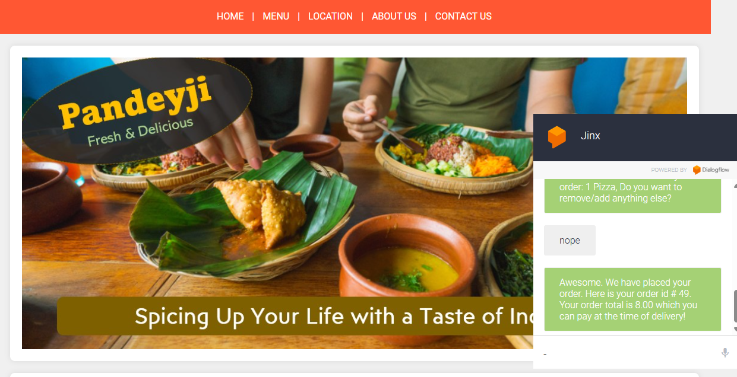
Overall Product

Slide 6
Team_Quanta
Preet Shah(Admin)
Aarya Shah
Abdul Kadir
Niket Singhla

